Slide 1
AI-Driven Sentiment Analysis for Community Policing
By Team Cyber Cipher

Slide 2

Problem statement
Building a sentiment analysis tool that monitors social media and local news for public sentiment regarding law enforcement. The system should help identify community concerns and public sentiment trends.

Slide 3
Communisense
AI DRIven Tool to eliminate public concerns and misinformers

Slide 4
use cases
improve community relations and engagement
Policy Evaluation and Adjustment
detect and respond swiftly to emerging issues
prevent and manage potential conflicts
Public Perception Monitoring
Performance Measurement

Slide 5
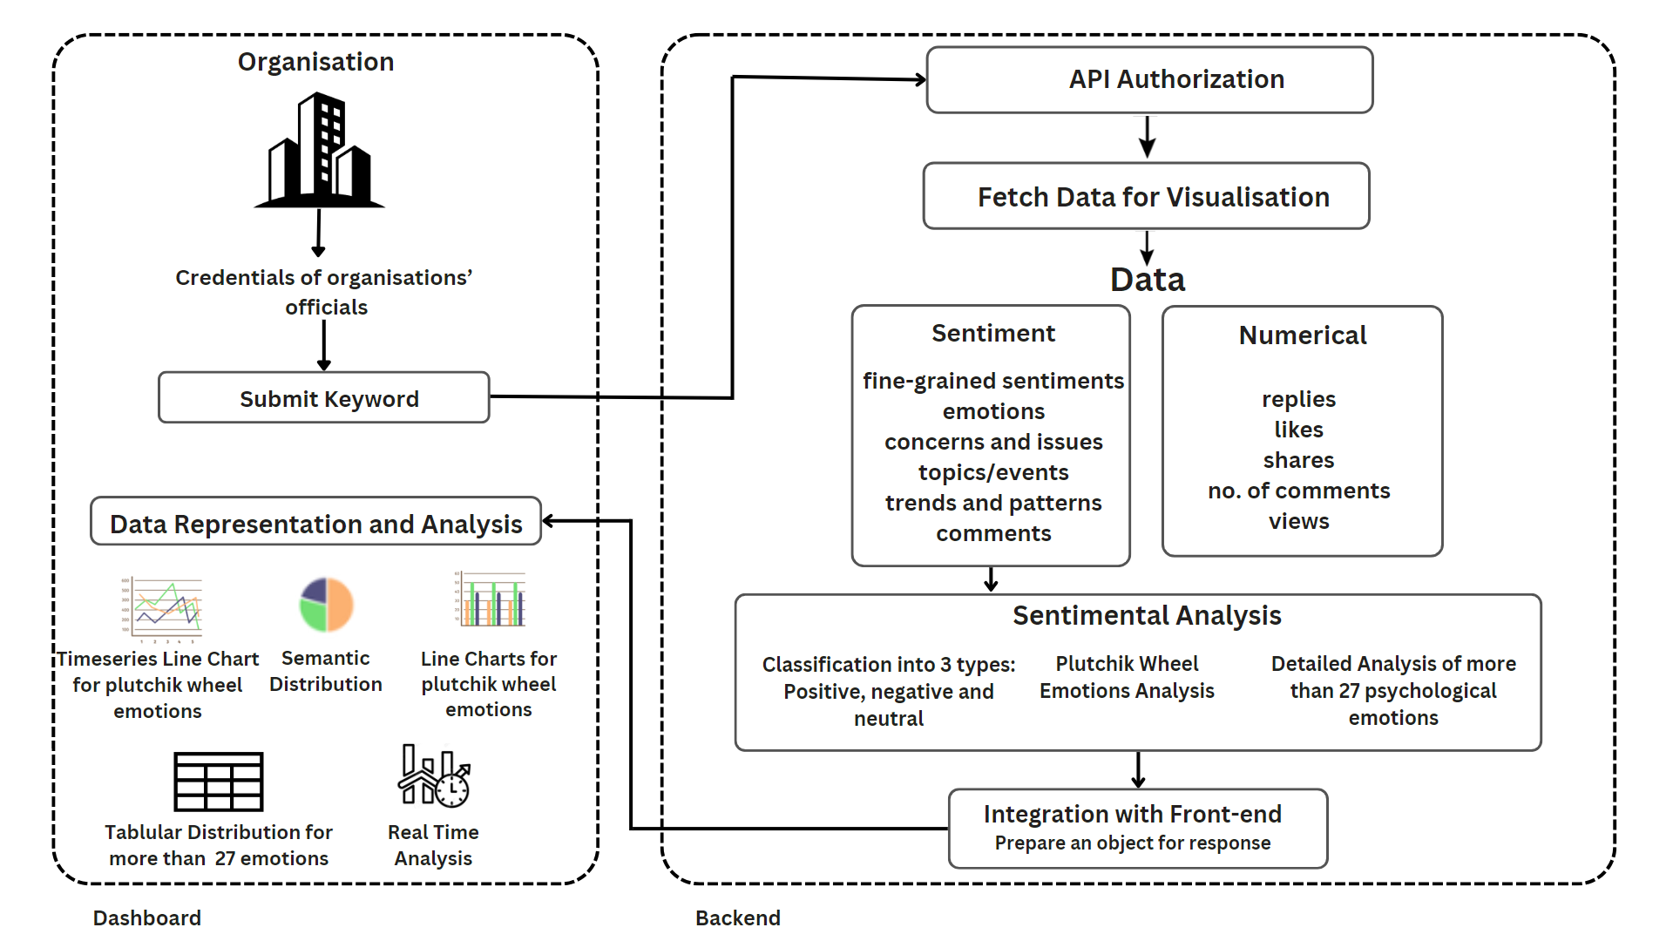
system architecture

Slide 6
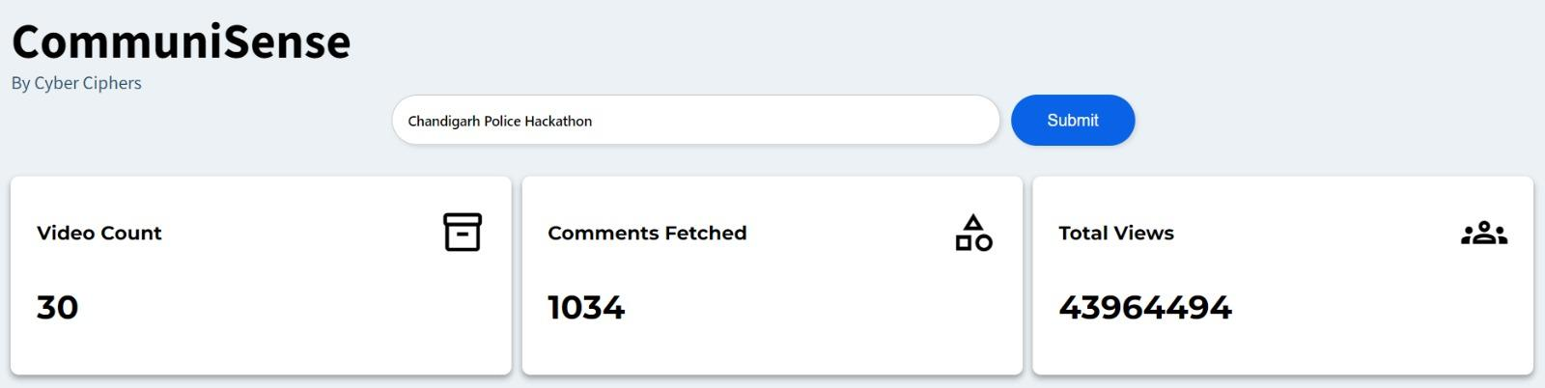
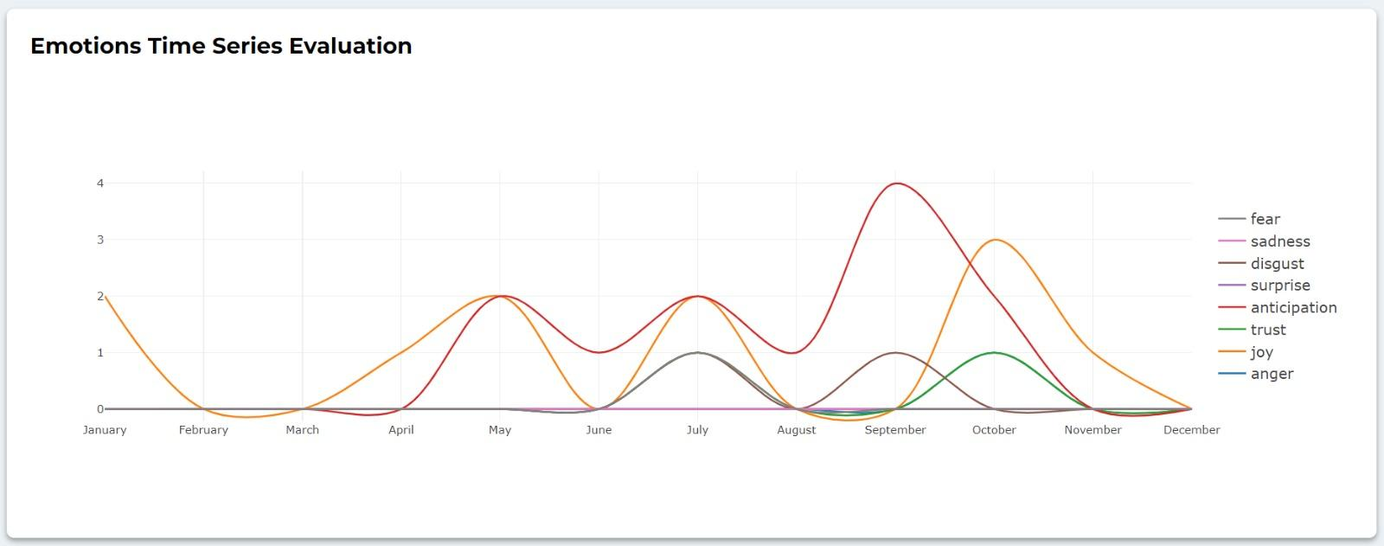
system working

Slide 7
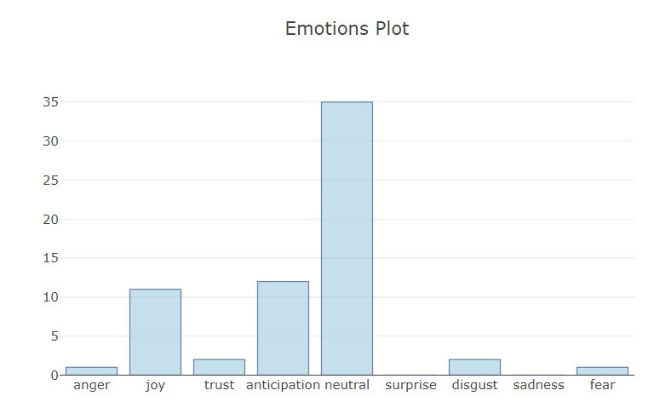
system working

Slide 8
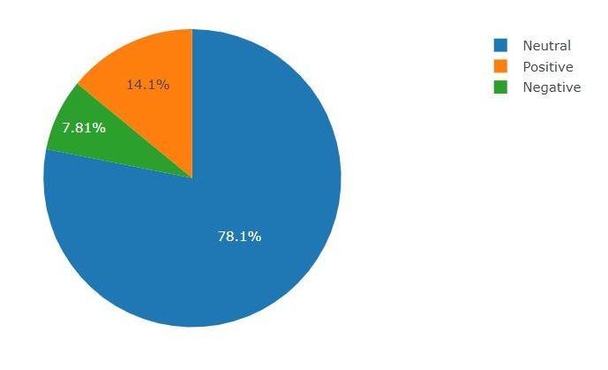
system working

Slide 9
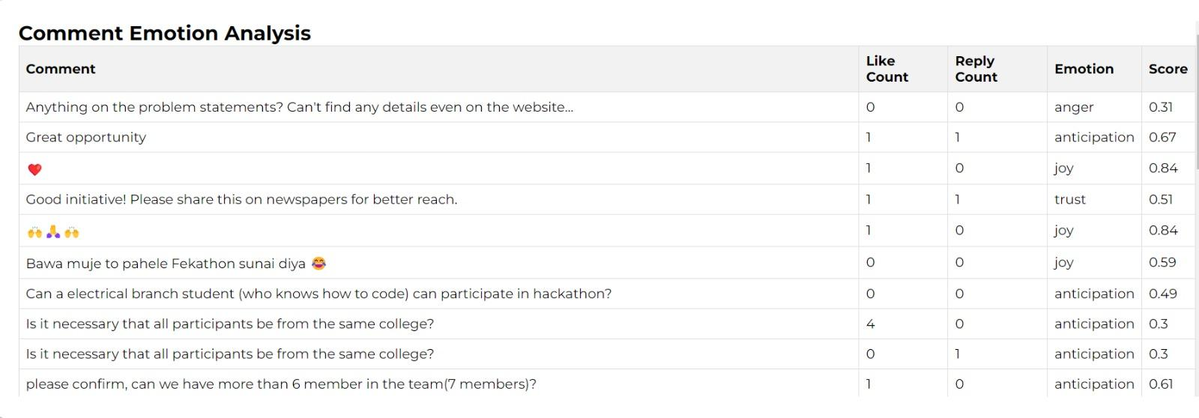
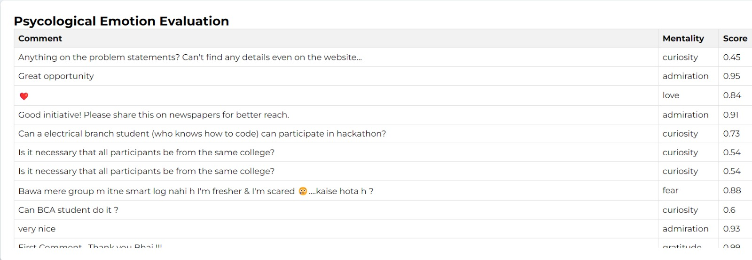
system working

Slide 10
Future scope
Collaboration and personal customization for other agencies
Integrate more platforms and data sources
Scalable to mobile application

Slide 11
Thanks!
Do you have any questions?

